Slide 2
Objectives
Understand the meaning of a sensor
Understand the purpose of the following sensors
Acoustic
Accelerometer
Flow
Gas
Humidity
Infra-red
Level
Light
Magnetic field
Moisture
pH
Pressure
Proximity
Temperature

Slide 3
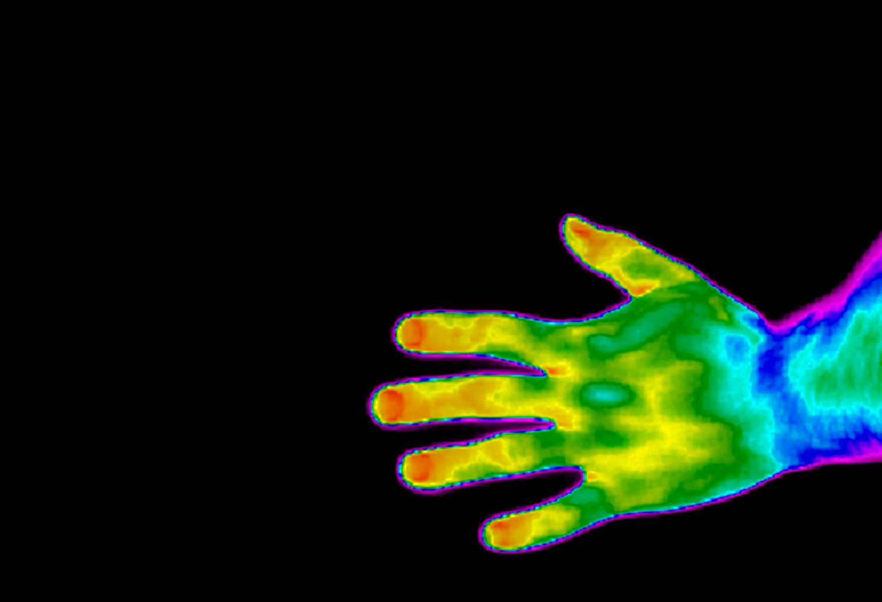

Starter
Sensors measure physical properties such as temperature
List at least five other physical properties that could be measured

Slide 4
Starter
Some physical properties that can be measured:
Sound intensity
Acceleration
Pressure
Light intensity
Infra-red (heat) intensity
Magnetic field
Moisture
pH
Distance

Slide 5
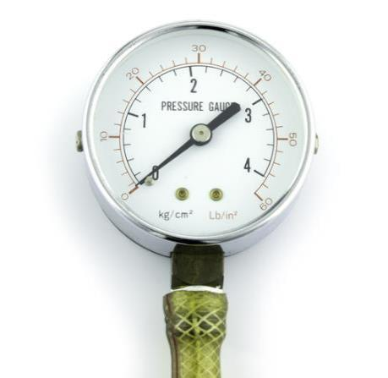
Sensors
The definition of a sensor is:
“A hardware device that can take measurement of physical properties, such as temperature or pressure, from real world surroundings. These measurements are usually a representation of the actual property being measured.”
Data taken by sensors is usually in analogue form

Slide 6
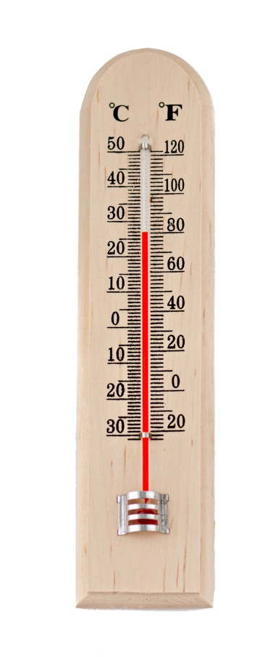
Analogue measurements
Analogue means that data has no discrete value and the data changes smoothly rather than in exact jumps
Examples include:
A thermometer where temperature is represented by the height of the mercury
A speedometer showing speed represented by a needle on a gauge
A seismometer recording the force and duration of ground movement by visualising the motion of a weight on a string using a pen

Slide 7
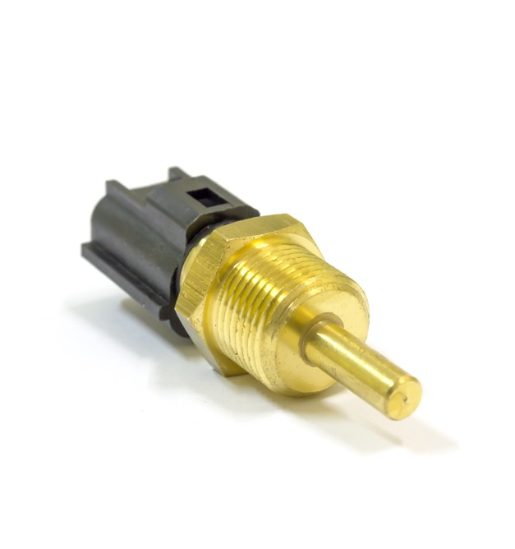
Car temperature sensors
Cars have many sensors that are constantly monitoring the physical state of the car components
For instance, a temperature sensor is used to monitor the temperature of the cooling system
If the temperature gets too hot, a fan can be turned on or the driver can be alerted to the problem
Cars may also monitor the temperature inside the car, applying heaters or air conditioning as appropriate
What other sensors are used in cars?

Slide 8
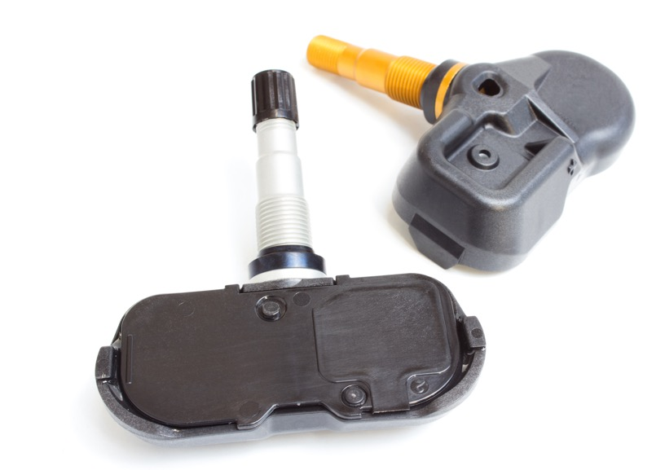
Pressure sensors
Pressure sensors are now required inside car tyres on all new cars
These are located behind the tyre valve used to inflate the tyre
They constantly transmit the pressure to the engine control unit (ECU)
If the ECU detects the pressure is too low, such as with a slow puncture, it will display a warning to the driver

Slide 9
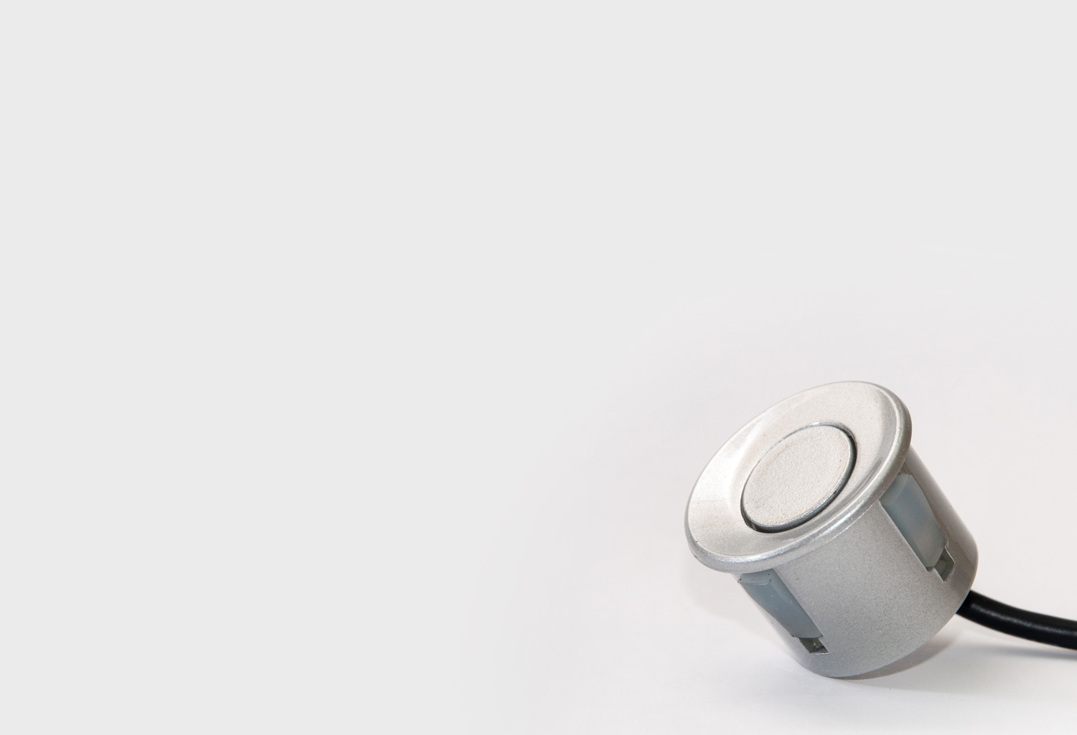
Proximity sensors
Car proximity sensors make use of ultrasound
A sound wave is transmitted from the car
An echo is produced from a nearby object
The time it takes for the echo to be received allows the distance to be calculated
These sensors are helpful to drivers when reversing as they warn of objects that they may reverse into
Smartphones also have sensors
What do you think a accelerometer does?

Slide 10
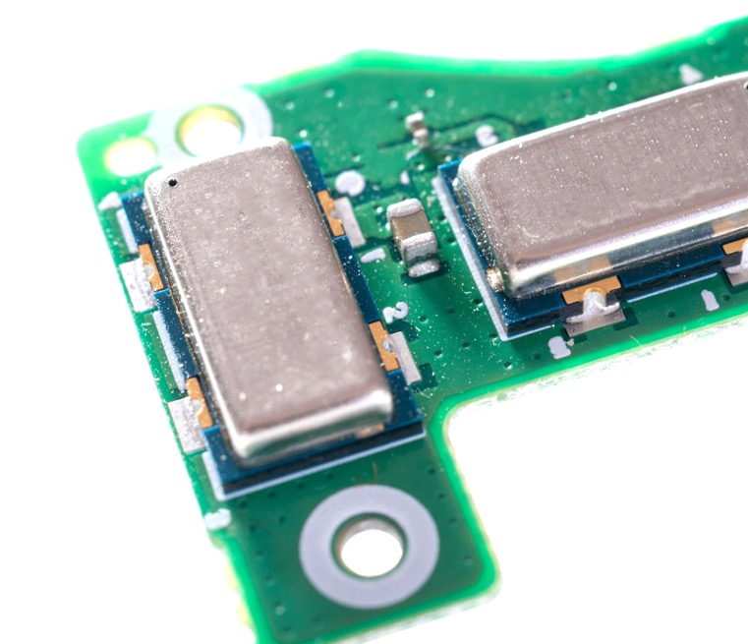
Accelerometers
An accelerometer measures the acceleration of an object and the direction it is moving in
In smartphones this is used to determine whether the phone is orientated in landscape or portrait
Some game controllers also use 3-axis accelerometers to determine the direction that the controller is moving

Slide 11
Other sensors
Type of sensor | Applications
Moisture sensor | control or monitor the dampness of soil in a greenhouse monitor the dampness of clothes as they pass over a sensor in a tumble dryer measure water content in a lawn for an automatic watering system
Humidity sensor | monitor the humidity in the air of a greenhouse control a dehumidifier in a home monitor the humidity in a factory making microchips
Level | monitor the amount of fuel in a car monitoring the amount of oil in a car’s engine measuring the height of flour in a food processing plant
Light | switch street lighting on at dusk and switch street lighting off at dawn automatically switch a car’s headlights on when it gets dark to close or open the window blinds in a greenhouse to maintain light levels
Infra-red | turn on a car’s windscreen wipers automatically when it starts to rain detection of intruders in a burglar alarm system count the number of people entering or leaving a supermarket
Flow | measure how quickly a chemical is moving through a pipe in a chemical plant measure the speed of water in water pipes monitor the flow of water in a river
Acoustic | pick up noise levels (e.g. footsteps) in a burglar alarm system detect the noise of liquids dripping from a pipe in an oil refinery monitor the sound levels in a car factory
Gas | monitor CO₂/O₂ levels in a river monitor CO₂/CO/O₂ levels in the air beside a road check for the carbon monoxide levels in a car exhaust system
pH | monitor or control the acidity levels in a chemical process measurement of pollution levels in a river check acidity levels in the soil in an agricultural field
Magnetic field | used in smart phones so they know which direction it is pointing used in the motors of CD players used in vehicle anti-lock braking systems

Slide 12
Worksheet 3
Complete Task 1 on Worksheet 3

Slide 13
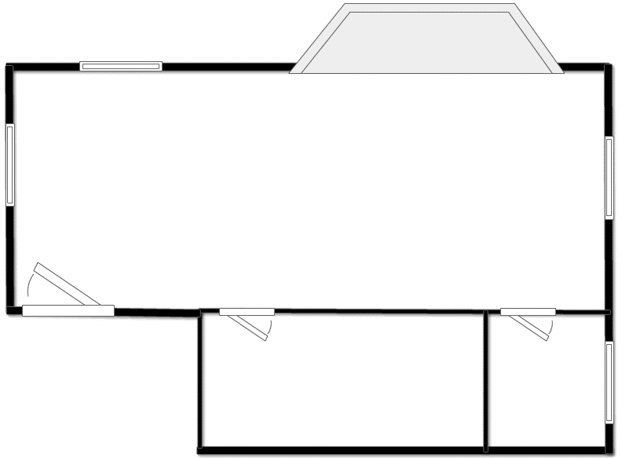



Security system
The diagram shows three sensors being used as part of an art gallery’s security system
What do each of the sensors do?
Pressure sensor
Infra-red sensor
acoustic sensor

Slide 14



Detection systems
The pressure sensors monitor an intruder stepping on the floor next to the windows, doors or on the floor next to valuable paintings
The acoustic sensors pick up the sound of breaking glass or footsteps on the floor
The infra-red sensors pick up movement in the rooms but also any changes in heat (e.g. heat radiation from an intruder)

Slide 15
Sensor feedback
Sensors constantly take readings for monitoring
The microprocessor will have access to pre-set values for all sensors
The microprocessor will sample each sensor at a given frequency (e.g. every second)
If any of the sensor readings exceed the pre-set values, then the microprocessor sends a signal to warn the user (this could be a screen output, a siren, a flashing light …. or all three)
Monitoring continues until the user keys in a PIN/passcode to deactivate the system

Slide 16
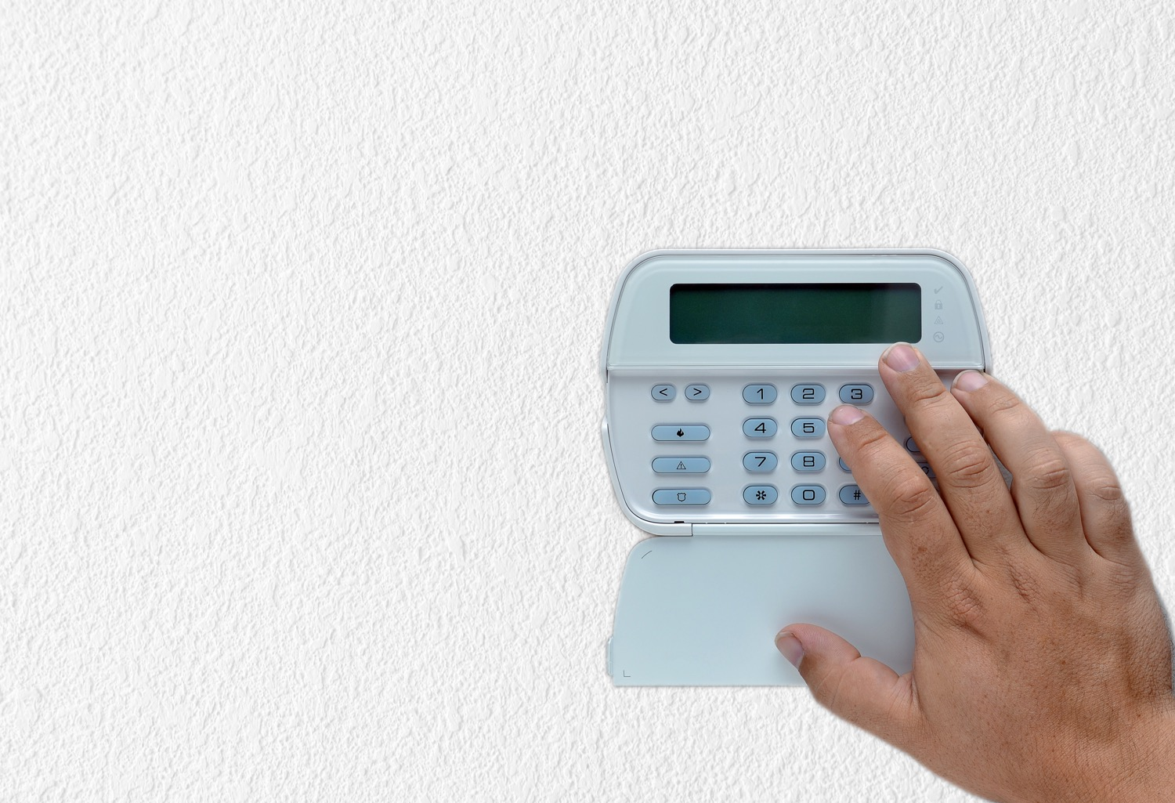
How it works
The system is first activated by the user keying in a PIN code or by placing an alarm fob near a receiver
Sensors constantly monitor the rooms for intruders
Data is converted into digital form using an Analogue to Digital Converter (ADC) and is sent to a microprocessor

Slide 17
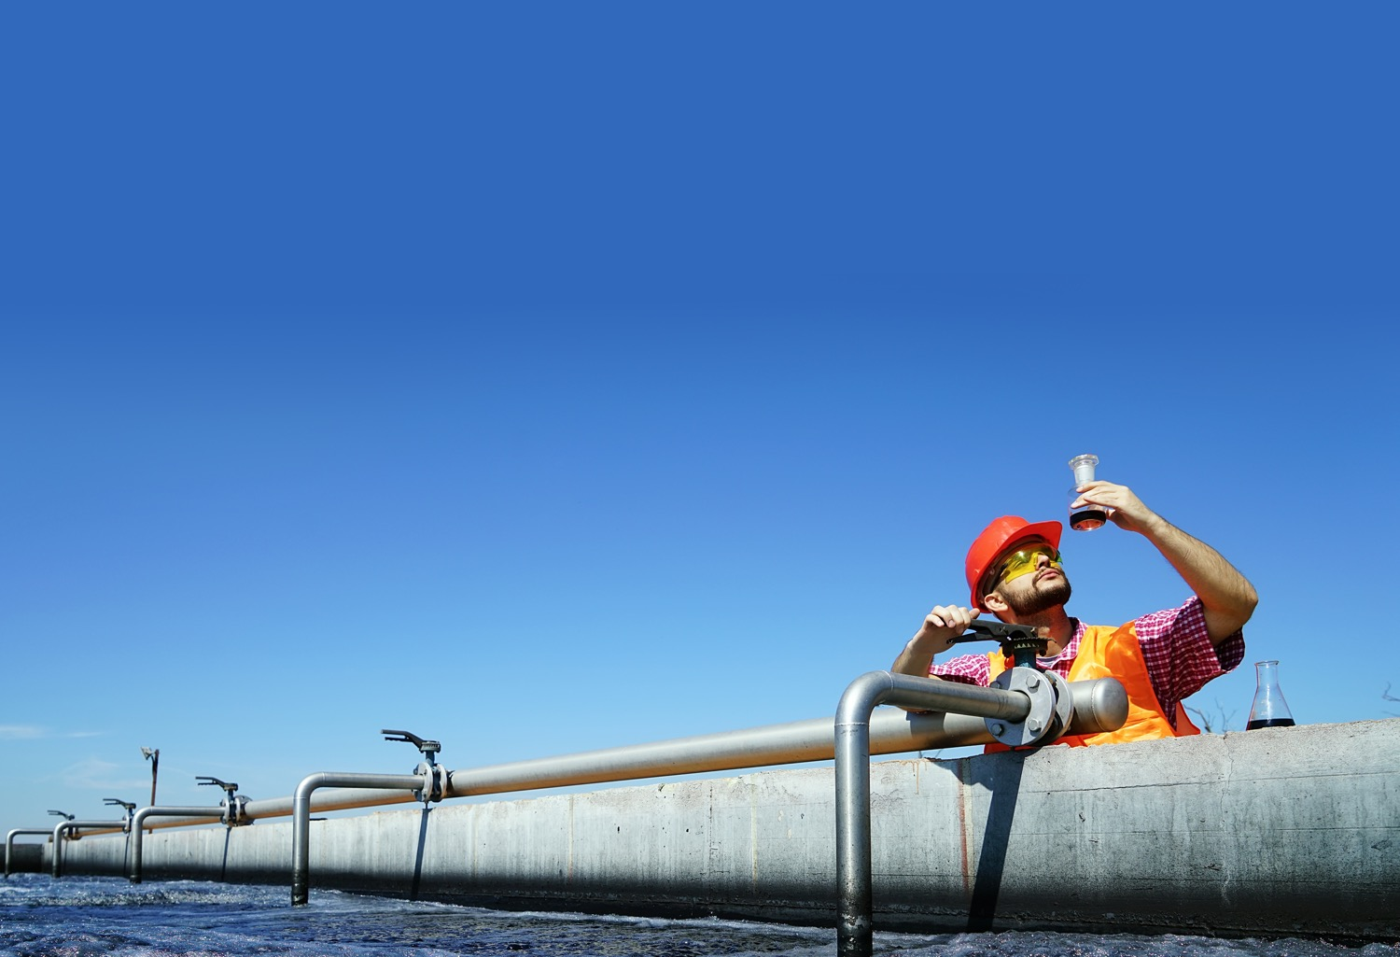
Water treatment
When waste water is treated, it is important that the pH is correct before it is discharged
A pH sensor detects how acidic or alkaline a liquid is
How would a system work to keep the pH constant would work?

Slide 18
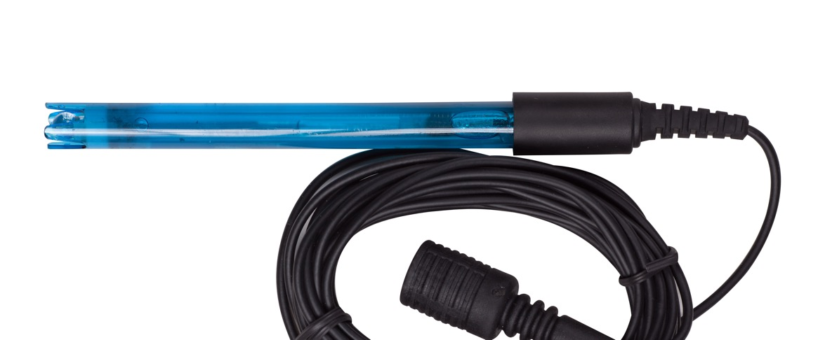
pH system
The pH sensor sends analogue data to a microprocessor about the pH currently being output
The system is programmed to be at a certain pH value, e.g. 7
If the pH goes below this value, it is acidic, so a valve will be opened so that a base (alkali) is added
If the pH goes above this value, it is alkali, so a valve will be opened to add an acid

Slide 19
Worksheet 3
Complete Task 2 and Task 3 on Worksheet 3

Slide 20


Plenary
An automated outdoor light comes on when it is dark enough and someone walks nearby
This light makes use of two sensors
Describe how the light works

Slide 21
Plenary
The automated light works as follows:
The user sets the light level required for the light to come on
An infra-red sensor detects any changes in movement by a person as they are warm and emit infra-red radiation
The infra-red sensor sends an analogue signal to an analogue to digital convertor (ADC)
A light sensor detects light intensity
If the light intensity is below the value the user set AND the infra-red sensor has detected sufficient movement, the light is turned on

